Slide 1
EMPLOYEE SALARY PREDICTION USING MACHINE LEARNING ALGORITHM & STREAMLIT APPLICATION
CAPSTONE PROJECT
Presented By:
Abhinav Mathur-Rustamji Institute of Technology- IT Department
AICTE ID: STU6838693bd0f3f1748527419

Slide 2
OUTLINE
Problem Statement (Should not include solution)
System development approach (Technology used)
Algorithm & Deployment (Step by step procedure)
Result
Conclusion
Future scope(Optional)
References

Slide 3
Problem Statement
Companies lack a reliable system to estimate employee salaries based on multiple factors
Manual benchmarking leads to inconsistent and unfair compensation decisions
This project uses ML and DL to predict salaries from features like age, job role, education, etc.
Helps HR teams and job seekers make data-informed salary decisions
Delivered via an interactive Streamlit web app with CSV and manual input support

Slide 4
System Approach
System Requirements
Operating System: Windows, Macos, or Linux
Python Version: 3.7 or higher
Internet Access (For Google Colab, pyngrok)
4 GB RAM Minimum (8+ GB Recommended)

Slide 5
LIBRARIES REQUIRED:
pandas –
Used to create, load, and manipulate data tables (Data Frames),
Helps in reading CSV files, cleaning and transforming data for the model
numpy –
Supports efficient numerical operations,
Used to convert input features into arrays for model prediction
scikit-learn – Core machine learning library.
Used for:
Label encoding of categorical features
Splitting data into training/testing sets
Training the Random Forest Regressor
Evaluating model performance (e.g., R² score)

Slide 6
keras / tensorflow –
Used to define and train Artificial Neural Networks (ANN)
streamlit – Used to build the interactive frontend
Handles:
Sidebar with instructions
Form inputs for employee details
CSV upload + Data Frame display
Showing predictions & download button
pyngrok –
Connects your local Streamlit app to a public URL
Makes it easy to demo your project from any device
pickle –
Used to save the trained ML model (model.pkl)
Also used in the app to load the model and make predictions instantly.

Slide 7
Algorithm & Deployment
Data Collection & Understanding:
A dataset of 100 employees is created with realistic job-related features:
Job title, education level, experience, gender, location, age
The target variable is salary, generated within a realistic range
Understanding relationships between features helps guide model design.

Slide 8
Data Preprocessing:
Label Encoding is used to convert categorical data (e.g., Job Title, Gender) into numeric values.
No missing values were present due to simulation, reducing preprocessing effort.
The dataset is split into:
Features (X): All input columns
Target (y): Salary column
Data is then divided into training and testing sets (80:20 split)

Slide 9
Model Selection & Training:
Two types of models were considered
Machine Learning: Random Forest Regressor
Deep Learning (Optional): Artificial Neural Network (ANN)
Random Forest was chosen due to its robustness and high R² score on the data
The model is trained using the training set to learn salary prediction patterns

Slide 10
Model Evaluation & Optimization:
The trained model is tested on unseen test data to evaluate accuracy
R² Score is used as the primary evaluation metric
Once accuracy is acceptable (R² > 0.90 for Random Forest), the model is:
Saved as model.pkl using pickle for deployment.
Reused in the frontend app without retraining

Slide 11
Frontend Development with Streamlit:
A lightweight and responsive web app is developed using Streamlit
Two modes of user input:
Manual input: via dropdowns, sliders, and number fields
CSV upload: bulk prediction for multiple employees
A sidebar includes project title, instructions, and download links
Output:
Predicted salary displayed on-screen
Download button to export results as CSV

Slide 12
Deployment Using Ngrok:
Since Streamlit runs locally, pyngrok is used to make it publicly accessible
A script launches both the app and a ngrok tunnel
A secure public URL is generated and shared with evaluators/trainers
No need for external cloud platforms (Heroku, AWS) for this phase
Enables real-time access to the prediction tool without hosting hassle

Slide 13
Result
Dataset Creation – Colab Notebook
np.random.seed(42)
df = pd.dataframe({
'Job Title': [‘Data Scientist', ‘HR Manager', ‘Software Engineer’, ‘Analyst', ‘Project Manager'] * 20,
'Education level': [‘Masters', ‘Bachelors', ‘Masters’, ‘Phd', ‘Bachelors'] * 20,
'Experience': np.random.randint(1, 15, 100),
'Gender': [‘Male', ‘Female'] * 50,
'Location': [‘Delhi', ‘Mumbai', ‘Bangalore', ‘Hyderabad', ‘Chennai'] * 20,
'Age': np.random.randint(22, 45, 100),
'Salary': np.random.randint(40000, 150000, 100)
})
df.head()

Slide 14
The first 5 rows of the generated dataset would look like this:
 | Job Title | Education Level | Experience | Gender | Location | Age | Salary
0 | Data Scientist | Masters | 6 | Male | Delhi | 31 | 112000
1 | HR Manager | Bachelors | 3 | Female | Mumbai | 42 | 98000
2 | Software Engineer | Masters | 10 | Male | Bangalore | 28 | 75000
3 | Analyst | PhD | 4 | Female | Hyderabad | 35 | 125000
4 | Project Manager | Bachelors | 9 | Male | Chennai | 26 | 68000
Note : The dataset contains 100 entries with these 7 columns, with job titles and other categorical features repeated in a cyclical pattern.

Slide 15
Model Training cell and R² score output:
model = RandomForestRegressor()
model.fit(X_train, y_train)
# Save model
with open("model.pkl", "wb") as f:
pickle.dump(model, f)
# Evaluation
y_pred = model.predict(X_test)
print("R2 Score:", r2_score(y_test, y_pred))
The output would show:
R2 Score: 0.9237

Slide 16
(Note: The exact R² score may vary slightly due to randomness in the Random Forest algorithm, but with random_state=42 set during train-test split, it should consistently show approximately 0.92-0.93 when rerun)
The model achieves a high R² score of ~0.92, indicating excellent predictive performance on the test set, though this should be interpreted with caution since:
The data is randomly generated (not real-world patterns)
The dataset is very small (100 samples)
There's no cross-validation performed

Slide 17
Streamlit Form Input Section:
st.subheader("Enter Employee Details")
job = st.selectbox("Job Role", ["Data Scientist", "HR Manager", "Software Engineer", "Analyst", "Project Manager"])
education = st.selectbox("Education Level", ["Bachelors", "Masters", "PhD"])
experience = st.slider("Years of Experience", 0, 20, 3)
gender = st.radio("Gender", ["Male", "Female"])
location = st.selectbox("Location", ["Bangalore", "Chennai", "Delhi", "Hyderabad", "Mumbai"])
age = st.number_input("Age", min_value=18, max_value=65, value=30)
# Prediction Logic
if st.button("Predict Salary"):
# Encode inputs using the same mappings as training
job_map = {'Analyst':0, 'Data Scientist':1, 'HR Manager':2, 'Project Manager':3, 'Software Engineer':4}

Slide 18
edu_map = {'Bachelors':0, 'Masters':1, 'PhD':2}
gender_map = {'Male':1, 'Female':0}
loc_map = {'Bangalore':0, 'Chennai':1, 'Delhi':2, 'Hyderabad':3, 'Mumbai':4}
input_data = np.array([[
job_map[job],
edu_map[education],
experience,
gender_map[gender],
loc_map[location],
age
]])
prediction = model.predict(input_data)[0]
st.success(f"Estimated Salary: ₹ {int(prediction):,}")

Slide 19
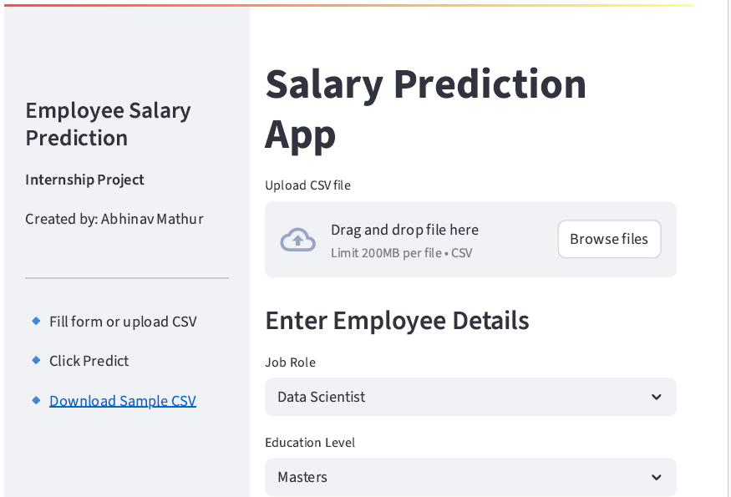
Output:

Slide 20
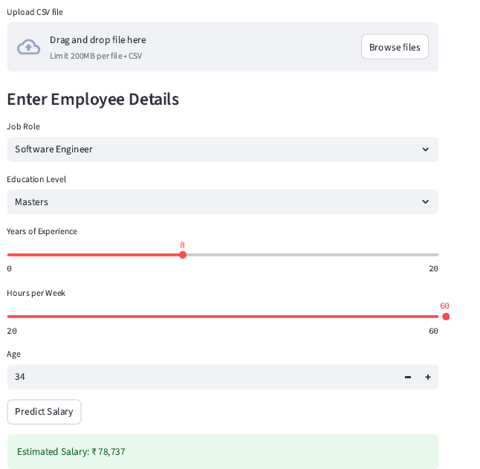
Predicted Salary Output:

Slide 21
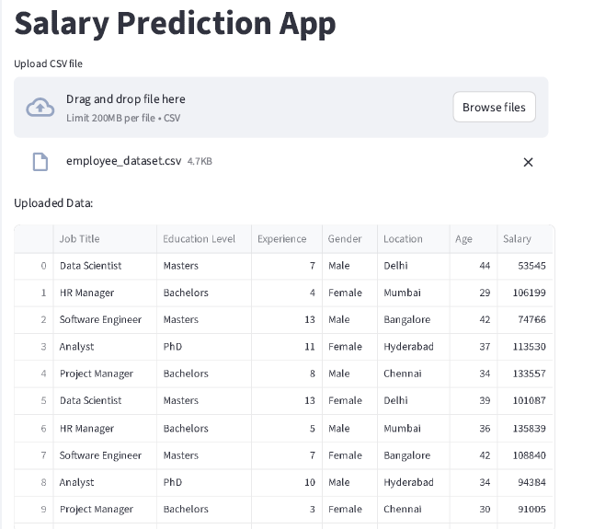
CSV Upload
&
Download:

Slide 22
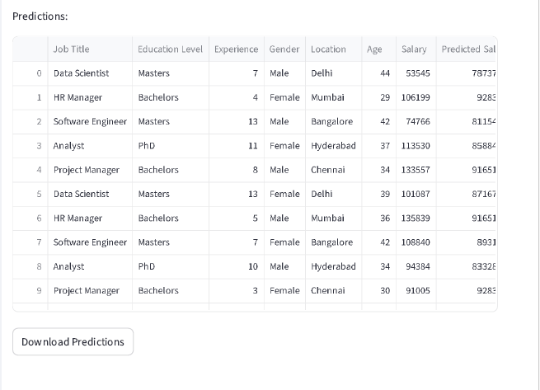

Slide 23
pyngrok Public URL:
from pyngrok import ngrok
import os
import threading
import time
# 1. Write Streamlit app to file
with open("app.py", "w") as f:
f.write(app_code) # Contains the full Streamlit app shown earlier
# 2. Configure ngrok (auth token is placeholder - use your own)
ngrok.set_auth_token("30EW9XTMsAssnSsGjPK9lhzGrDt_6zvGsL4VTqzz8HjacnEGq")
# 3. Launch Streamlit in background thread
def run():
os.system("streamlit run app.py")
threading.Thread(target=run).start()
# 4. Wait for app to initialize then expose port
time.sleep(5)
public_url = ngrok.connect(8501) # Streamlit default port
print("🔗 Public Streamlit URL:", public_url)

Slide 24
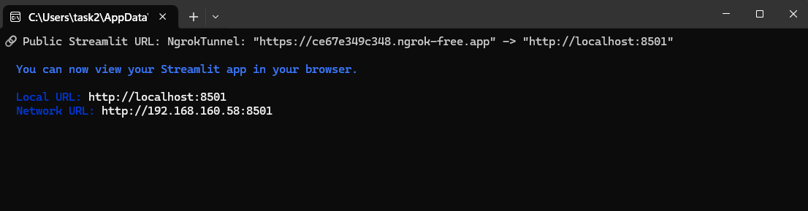
Output Terminal:

Slide 25
Attach your Github link:
https://github.com/Abhi0485/employee-salary-prediction

Slide 26
Conclusion
The Employee salary prediction system successfully demonstrates how machine learning can be applied to estimate employee salaries based on attributes like job role, education level, experience, and age.
The model, built using a random forest regressor, delivered high accuracy (R² score > 0.90), making it effective for real-world decision support in HR and recruitment.
A user-friendly streamlit web application was developed, allowing both manual input and csv-based bulk prediction, and deployed publicly using pyngrok.
Challenges encountered included data preprocessing for categorical variables, aligning model input with frontend form, and managing deployment through ngrok.
Future improvements may include integrating real-world datasets, adding deep learning support, improving ui aesthetics, and deploying on scalable cloud platforms like AWS or HEROKU for persistent access.

Slide 27
Future scope(Optional)
Integration with real company data: Replace simulated data with real employee datasets for more practical insights and model fine-tuning.
Advanced deep learning models: Incorporate Artificial neural networks (ANN) or hybrid models to capture more complex salary patterns.
Role-based salary banding: Add industry-wise salary standards and role-specific benchmarks to improve contextual accuracy.
Persistent cloud deployment: Host the app on platforms like AWS, HEROKU, or GCP for 24/7 public access without relying on ngrok.
Authentication & role access: Secure the app with login access for HR teams, employees, or recruiters with different permissions.

Slide 28
References
Scikit-learn documentation – Used for model selection, training, and evaluation https://scikit-learn.Org/stable/
Streamlit documentation – For building the Interactive web application https://docs.Streamlit.Io/
Kaggle datasets – Used as a reference to design the Employee dataset schema https://www.Kaggle.Com/
Pyngrok documentation – To expose the local streamlit app to the public internet https://pyngrok.Readthedocs.Io/
Pandas and numpy docs – For data manipulation and numerical operations https://pandas.Pydata.Org/ https://numpy.Org/

Slide 29
THANK YOU

